Slide 1
DSP Assignment-5 Changing Sampling Rate with FFT Filters
Assigned 2022/1/12

Slide 2
Objective
To understand up-sampling and down-sampling techniques
To implement an FFT low-pass filter with overlap-add method

Slide 3

Specification
T = 1/44100 sec for input signal
TM/L = 1/8000 sec for output signal
Input signal x[n]: input.wav, a stereo music file (44.1kHz, 16bits)
Output signal ${\tilde{x}}_{d}[n]$: output.wav, a stereo music file (8kHz, 16bits)

Slide 4
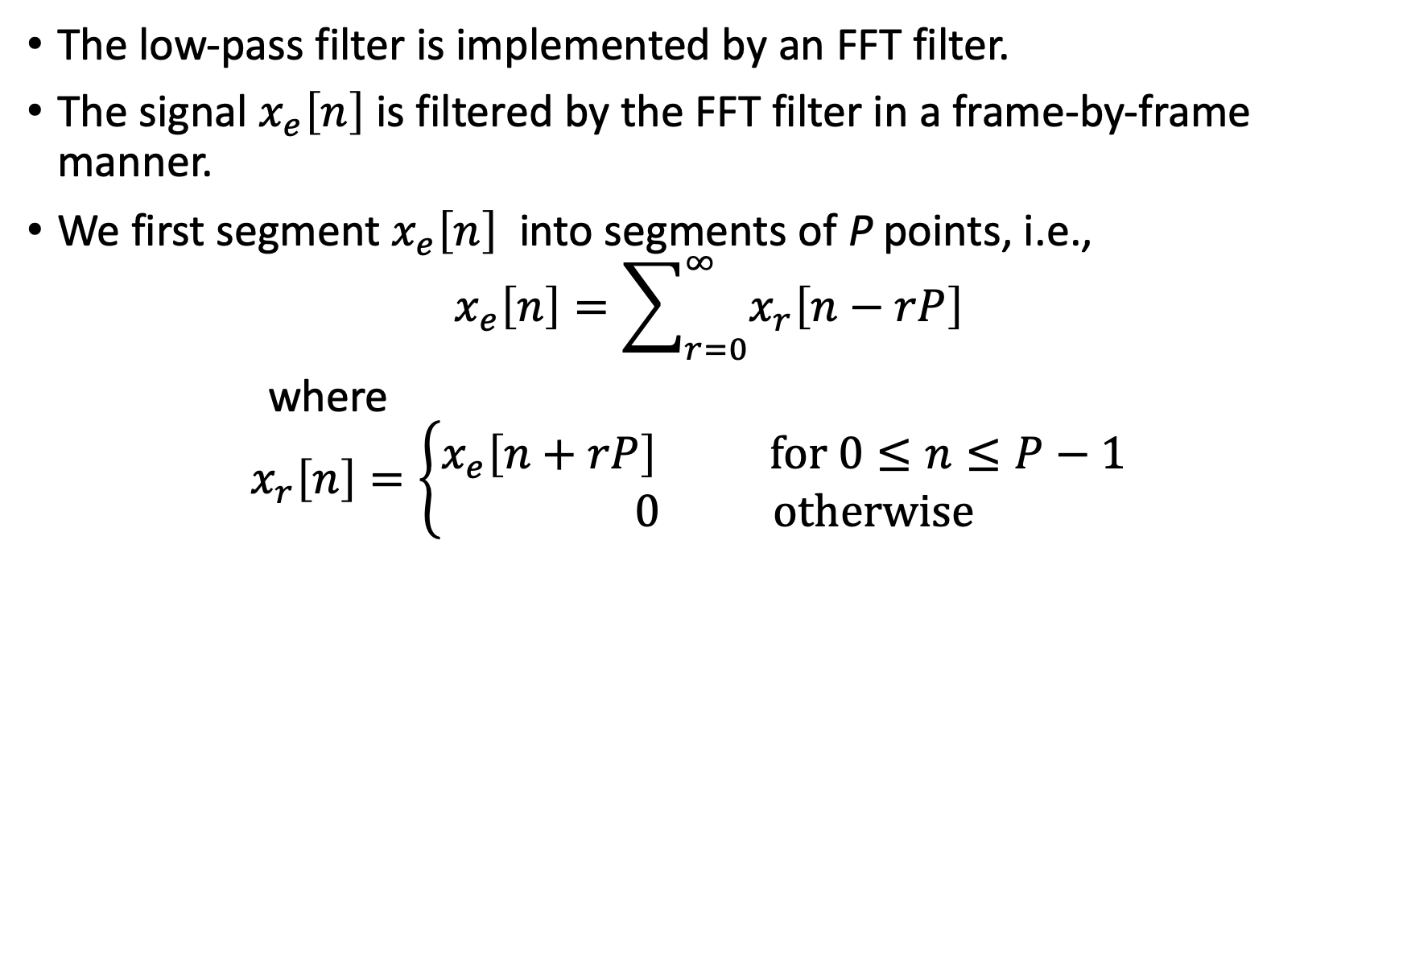
Low-Pass Filter
The low-pass filter is implemented by an FFT filter.
The signal $x_{e}\left[n\right]$ is filtered by the FFT filter in a frame-by-frame manner.
We first segment $x_{e}\left[n\right]$ into segments of P points, i.e.,
$$x_{e}\left[n\right]=\sum_{r=0}^{∞}{x_{r}\left[n−rP\right]}$$
where
$$x_{r}\left[n\right]=\left\{\begin{aligned}x_{e}\left[n+rP\right] \text{for}\text{ 0}≤n≤P−1 \\ 0 \text{otherwise}\end{aligned}\right.$$

Slide 5
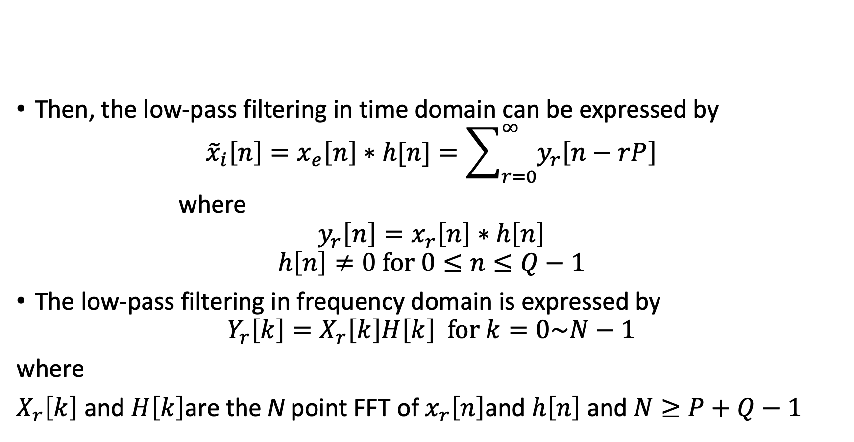
Low-Pass Filter
Then, the low-pass filtering in time domain can be expressed by
$${\tilde{x}}_{i}\left[n\right]=x_{e}\left[n\right]∗h[n]=\sum_{r=0}^{∞}{y_{r}\left[n−rP\right]}$$
where
$${y_{r}\left[n\right]=x}_{r}\left[n\right]∗h\left[n\right]$$
$$h\left[n\right]≠0 \text{for}\text{ 0}≤n≤Q−1$$
The low-pass filtering in frequency domain is expressed by
$${Y_{r}\left[k\right]=X}_{r}\left[k\right]H\left[k\right] \text{for} k=0\sim N−1$$
where
$X_{r}\left[k\right]$ and $H\left[k\right]$are the N point FFT of $x_{r}\left[n\right]$and $h\left[n\right]$ and $N≥P+Q−1$

Slide 6
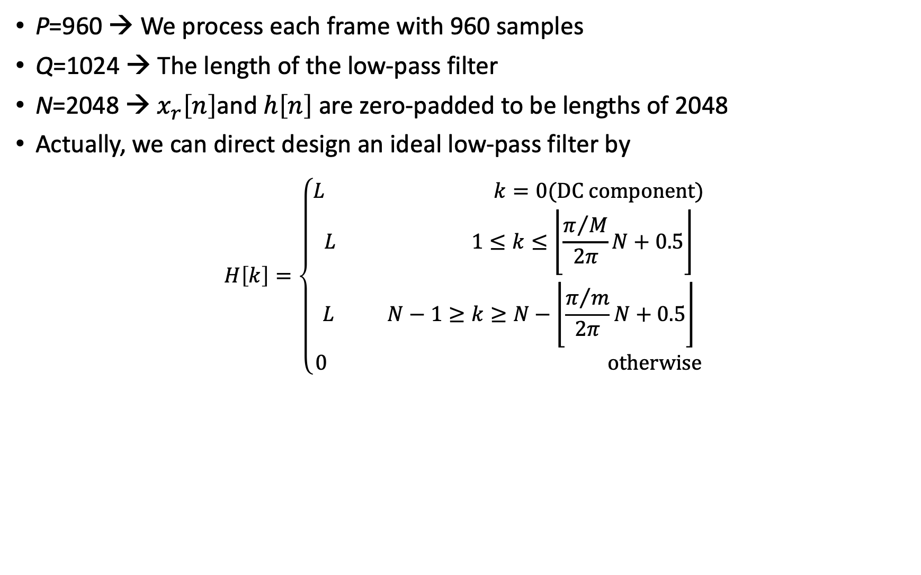
Parameters of FFT filter
P=960 → We process each frame with 960 samples
Q=1024 → The length of the low-pass filter
N=2048 → $x_{r}\left[n\right]$and $h\left[n\right]$ are zero-padded to be lengths of 2048
Actually, we can direct design an ideal low-pass filter by
$$H\left[k\right]=\left\{\begin{aligned}L k=0\text{(}\text{DC} \text{component}) \\ L \text{ 1}≤k≤\left.\left\lfloor \frac{π/M}{2π}\right.N+0.5\right\rfloor \\ L N−\text{1}≥k≥N−\left.\left\lfloor \frac{π/m}{2π}\right.N+0.5\right\rfloor \\ 0 \text{otherwise}\end{aligned}\right.$$

Slide 7
Requirement
All the program must be written in C
The low-pass filtering must be implemented by the overlap-add method.
The output.wav can be played by media player
Due: 2022/1/27

